Slide 1





Annual Interagency Accessibility Forum
Beyond Compliance: Building a Culture of Digital Accessibility
November 7-9, 2023
Should You Compromise on Your Greatest Abilities When You Have a Disability?”
The career journey of one individual from linguist to accommodations specialist.

Slide 2
Introduction
Physical description (complexion and outfit)
Presently working as an Accessibility Specialist at the U.S. Department of State
Education and natural skill is learning languages, along with a passion for clear communication
Presentation Goal: Must you compromise on an innate talent because of a disability?
If your skill is different from what your disability brings forth (such as a passion for accessibility and accommodations), is it possible to be active in both?

Slide 3
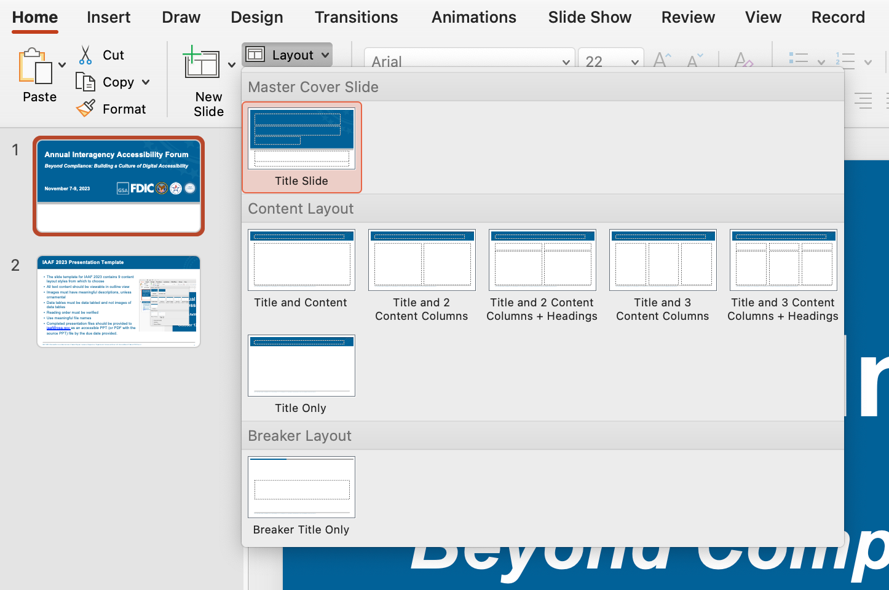
Objectives
Rose Marie Juan-Austin (poet): “An Innate Talent [is a] gift like breathing”
Some of us are good at playing an instrument, others at sketching, and still others at managing large projects
My gift has been language
Recently discovered that I can convert that skill to writing.
Explain how I have tried not to lose sight of my gift of gab (language) during my three distinct career paths:
Foreign-policy analyst
IT specialist (for desktop support and coding)
Accommodation specialist

Slide 4
My Language Origin Story
Discovered that I had a knack for learning languages, when I was 10, during a family summer trip to India
India has 22 official languages, and I managed to learn to communicate in three, using a 10-year-old’s vocabulary
That trip served as the wellspring of inspiration to a linguistics degree at Georgetown University and career in foreign policy after graduating, and, later, at the State Department

Slide 5
Foreign Policy Career
Linguistics degree brought me to a career in foreign policy
Served as a practical outlet for my talents because understanding of language is seldom separate from cultural and geopolitics
Worked as an analyst on India and Pakistan
Had to prematurely place my hopes on hold due to limitations in screen-reading technology for reading Urdu and Hindi
After a 20-year interlude into a technology and disability services career, I was able to get a chance doing foreign-policy analysis at the State Department at a time when screen-reading technology for foreign languages had vastly improved

Slide 6
IT Support Specialist Career
Worked as a technology trainer for the Columbia Lighthouse for the Blind (CLB) and tech-support specialist for Freedom Scientific and the U.S. Department of State
Tech training required technical writing skills for clients, and strong foreign-language skills provided a solid foundation for clear communication in English
Tech support required writing knowledge-base articles, and the same communication skills served as a great help

Slide 7
Accommodations Specialist
My work with reasonable accommodations and accessibility (in VA, DHS, and State Department) was a means to give back to the elements that have made a difference in my own career
Foreign-language skills have helped improve my awareness in everyday customer communications in English
In the State Department, it has helped me uniquely connect with individuals that we serve around the world (from locally employed staff, to foreign-service officers)
My knowledge of French and Spanish also helped our office test and approve Dragon dictation software in both those languages for two State Department translators

Slide 8
Concluding Thoughts
Motivation and tools help carve out a career
I can only thank the support of family, friends and colleagues for encouraging my aspirations
The outlet for talents are not always apparent and require patience
The way I could express my own talents were not always self-evident
There are so many other stories like my own, waiting to be heard

Slide 9
IAAF 2023 Presentation Template
The slide template for IAAF 2023 contains 8 content layout styles from which to choose
Any new layouts should be created in the Slide Master so that all text content should be viewable in outline view
Images must have meaningful Alt Text descriptions, unless ornamental
Data tables must be actual data tables and not images of data tables
Reading order must be verified
Use meaningful file names ending in “- IAAF 2023.pptx”
Completed presentation files should be provided to iaaf@gsa.gov as an accessible PPT (or PDF with the source PPT) file by the due date provided.

